Slide 1
GROUP -4
 | Name | Student ID
1 | Nipun | HS21910722
2 | Kalindu | HS21882012
3 | Anjalika | HS21911026
4 | Diluki | HS21908224
5 | Kaveesha | HS21909450
6 | Samindi | HS21907166

Slide 2
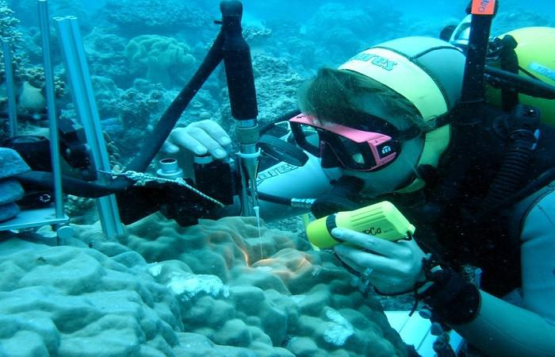
Blue Ocean With Biotechnology..!
NO WATER​
NO LIFE​
NO BLUE​
NO GREEN​
​
-SYLVIA EARLE-​
MARINE BIOLOGIST​
What is Marine Biotechnology?
The creation of products and process from Marine Organisms
The application of Biotechnology
Molecular and Cell biology
Bioinformatics
An innovative field of research
Science and Technology
The support of living organisms
Marine products and tools

Slide 3
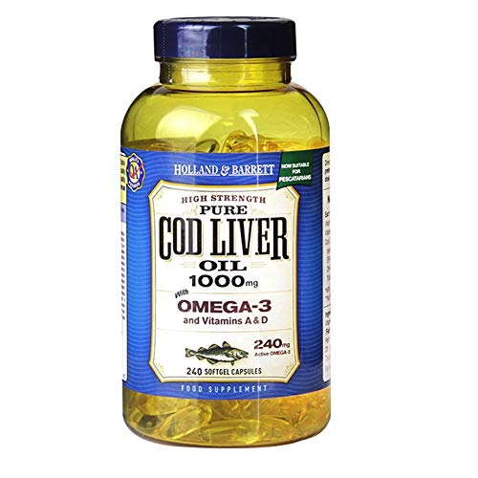
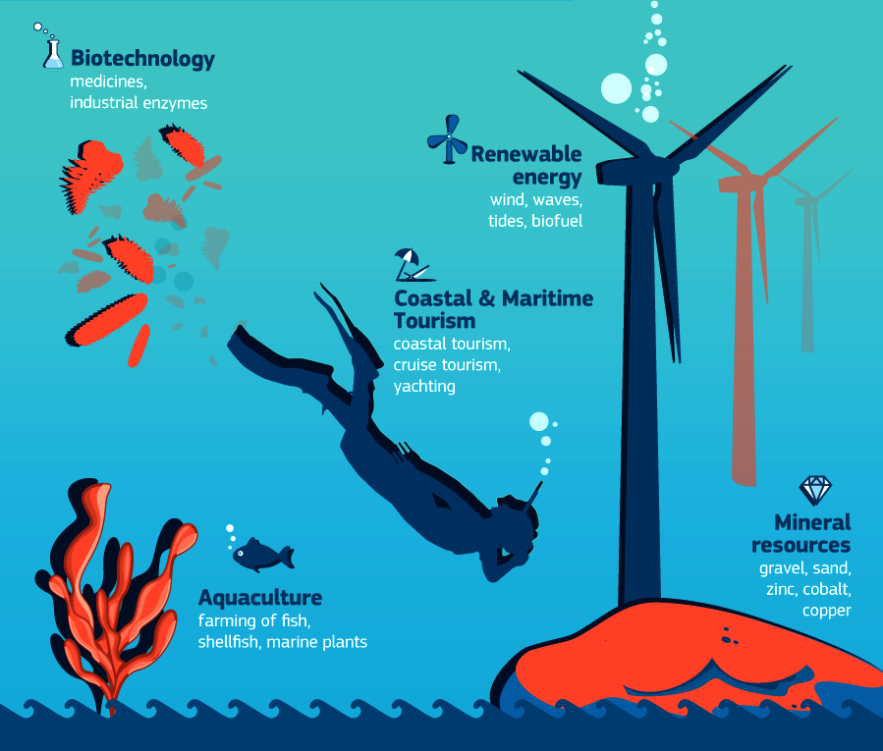
Use natural molecules
Living marine micro organisms
Reproduce
Lab environment
Do you know?
Over 2000 years ago extracts from marine organisms were used as medicine.
In the 19th and 20th century Cod Liver Oil was one of the famous nutritional supplement.
Deal with ocean exploration
Development of
Deal with advancement of
New drugs
Chemical products
Food products etc.
Aquaculture
Seafood safety
Bioremediation
Bio fuels

Slide 4
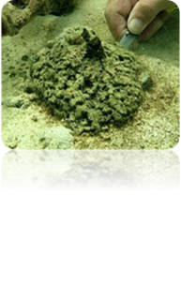
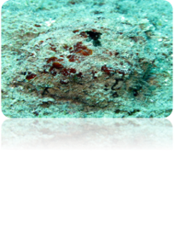
THE BEGINNING OF MARINE BIOTECHNOLOGY
How Did Marine Biotechnology Begin?​
Focus shifted from land-based bio-resources to
marine bio-resources.​
Marine bio-resources have a great variety​.
The discovery of nucleic acid material containing the unusual sugar
arabinose in the Caribbean sponge Tethya crypta.​

Slide 5


In 1967, “DRUG FROM THE SEA” conference (USA) lead the establishment of marine natural science as a research filed.​
In 1980s, research in marine biotechnology expanded.​
In marine biotechnology terminology came up with the IMBA conference in Japan.​​
National oceanic and atmospheric administration (NOAA) organized a program.​
Its major research focus was on applying to marine organisms the modern biotechnology methods found in molecular biology and genetic engineering. ​
Marine biotechnology is a future oriented industry.​

Slide 6
Importance of Marine Biotechnology​
One of the youngest biotech approaches​
Makes a huge contribution to the growth of the economy in future​
Marine bio resources could produce new products and process​
​
Health & medicine
Industrial products​
Food supply​
Marine Biotechnology​
Alternative energy sources​
Aqua culture​
Aqua culture​

Slide 7
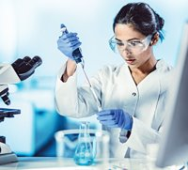
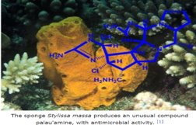
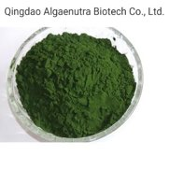
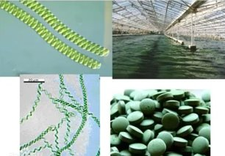
01).Health & medicine
Biological species in the oceans are rich sources of medicine​
Discovering new drugs​
> Marine derived anticancer drugs , antibiotics, painkillers​
Protein & enzymes derived from marine organism​
02).Food supply
An integral part of human nutrition​
Nutraceuticals developed from marine environment​

Slide 8
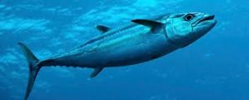
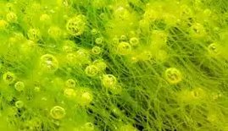

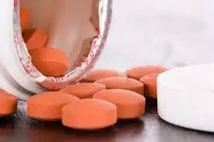
03).Transgenic fish​
​Major tasks ​
– enhance quality, growth, resistance and productivity​
Atlantic salmon, Tilapia, Common carp, Rainbow trout​
04).Alternative energy source
​ Biofuel from microalgae ​
Japan, United states, United kingdom​
05).For many industries
Cosmetic, Health ​
– fish, corals, sea cucumbers​
Omega-3, soaps, lotions, hair products​
GFP

Slide 9

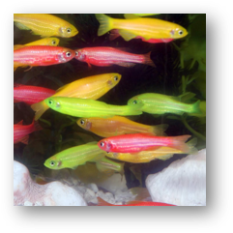
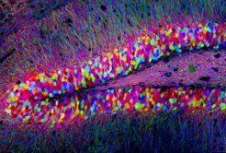
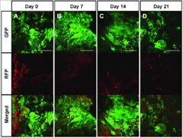
GFP-Green Fluorescent Protein
Osamu Shimomura​
Nobel Prize – 2008 - Chemistry
​

Slide 10
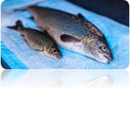


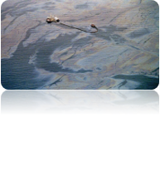
NEW TRENDS OF MARINE BIOTECHNOLOGY​
AGRICULTURAL TECHNIQUE ​
Marine biotechnology has improved aquaculture to genetic engineer sea species.​
It help the growing demand for seafood.​
Species include shellfish, striped bass salmon, and abalone and blue mussels.​
INDUSTRIAL PRODUCTS​
Thermophiles and psychrophiles is the latest discoveries of marine biotechnology.​
Those enzymes are the basis of the process known as polymerase chain reaction, or PCR.​
PCR is widely used with the development in the field of biotechnology , including DNA fingerprinting. ​
Bioremediation ​
Bioremediation speeds the natural degradation process. ​
It is being used to clean up sewage , sludge , seafood wastes, oil spills and toxins in marine areas. ​
By using genetically modified marine organisms​

Slide 11

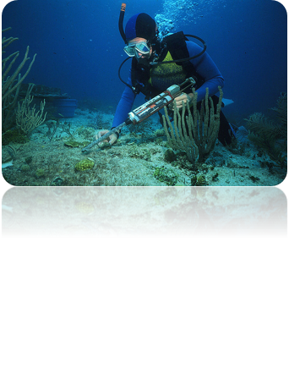
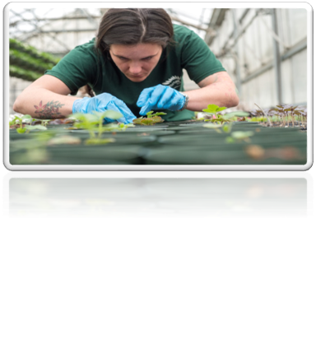
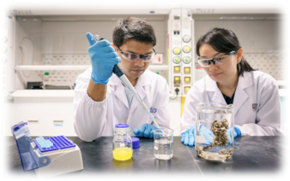
Career Opportunities Of Marine Biotechnology ​
Marine Biotechnology is an ever – evolving field, so continuous professional development in Technical and Practical skills, and relevant research is a vital part of the work.​
Research Biologist​
Biological Scientist​
Aquatic Scientist ​
Microbiologist​
Horticulturist​

Slide 12
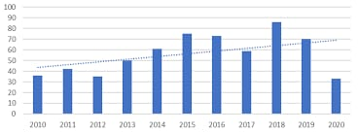
Future of blue biotechnology…​
Market of Marine Biotechnology
North-America has the largest market for marine biotechnology !​
The market is estimated to reach $6.4 million by 2025 and $7.3 million by 2026.​
Even though there has been a rising interest of this topic, there
are some boundaries when it comes to
the quantity of the products.​
Worldwide scientific production from​
2010 to 2020. -[MDPI]​

Slide 13
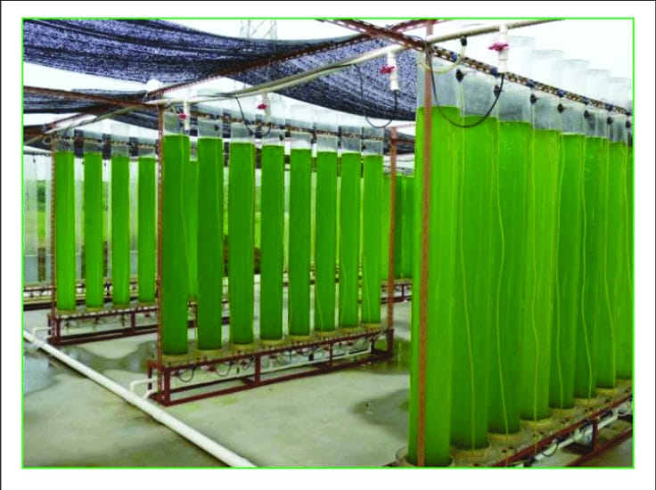
Future applications​
Bio – Prospecting​
Photobioreactors​
Production of novel products:​
-
40 L vertical tubular outdoor photobioreactor​
for Chlorella zofingiensis G1 cultivation.- ​
food​
diagnostics​
biosensors​
Challenges and solutions
​How developed microbes vary their production while interacting with the environment?
Technological barriers​
Economical challenges​
Social challenges ​
“The bioeconomy offers technological solutions for many challenges facing the world…achieving its potential will require appropriate national, regional and in some cases global policies”​
- OECD: The Bioeconomy to 2030:
designing a policy agenda​

Slide 14
Thank you..!

